Slide 1
Ethical Considerations in human subjects research
Lissie Bates-haus
Dacss Masters candidate
29 march 2022
Notes:
Long-standing academic interest in ethical concerns
Ethical considerations as a psychologist
Interest reignited in DACSS 697 Causal Inference with Dr. Alex Theodoridis

Slide 2
Why does this matter?
The issue of ethical practice in field research is of critical importance because field research, at the heart of it, involves the manipulation of real-world circumstances in real people’s lives.

Slide 3
Big Picture question
How are the ethical considerations of designing and executing human subjects research communicated to students, young professionals, and within an academic discipline as a whole?

Slide 4
Ethical Principles
Treat people as ends in and of themselves, not means to an end.
Practical Application: Informed Consent
Information must be comprehensive, accessible and understandable to potential participants
Autonomy
Withdrawal without punishment or retaliation
Respect for Persons
Beneficence
Justice
General principal of doing good.
Do not harm
Maximize possible benefits and minimize possible harms
Who ought to bear its burdens of the research and receive the benefits?
Practical Application:
Selection of research subjects (Belmont Report emphasizes this)
Focus on vulnerable populations
Who benefits? Aka can participants afford the benefits? If not, should they be provided? At whose cost?
Practical Application: Evaluation
Seeking balance between the benefit of the research and the potential harm done
Possible ethical conflicts
Notes:
The principles I’m going to be discussing generally come out of the field of biomedical research. Post WWII, the Nuremberg Code was developed after the atrocities committed by the NAZIs came to light, and served as the basis for other foundational codes of ethics, including the Helsinki Declaration which was adopted by the World Medical Association in 1964 and the Belmont Report, which was signed into law in the US in 1978.
RELEVANT: Desposato (2018) found that for for research designs (where deception is involved, there is not clear-cut normative value, and consent is not obtained), almost half of the citizen sample would prefer not to be involved in the research.

Slide 5
Respect for Persons
Treat people as ends in and of themselves, not means to an end.
Practical Application: Informed Consent
Information must be accessible and understandable to potential participants
Autonomy
Withdrawal without Punishment

Slide 6
beneficence
General principal of doing good.
Do not harm
Maximize possible benefits and minimize possible harms
Practical Application:
evaluate the balance between the benefit of the research and the potential harm done
[note the possible ethical conflict here]

Slide 7
Justice
Who ought to receive the benefits of the research and bear its burdens?
Practical Application:
Selection of research subjects (Belmont Report focuses on this)
Focus on vulnerable populations
Who benefits? Aka can participants afford the benefits? If not, should they be provided? At whose cost?

Slide 8
Other ethical considerations
The ethics of conducting research in developing nations
Results communication (how will you? Can you?)
Confidentiality and/or anonymity of subjects’ identity
Safety of participants and field staff
Protection of data in the digital era (particularly in the increasing push for transparency and replicability)
IRB vs an integrated ethical perspective
Issues related to machine learning
Who owns your data?

Slide 9
Possible ways ethical standards are communicated
Informally (mentoring)
Coursework (either specific units or integrated throughout the course)
Textbooks
Professional Organizations
Publications

Slide 10
Pilot study conducted for causal inference class
Journal articles collected from American Journal of Political Science and American Economics Review
“Field Experiment” in either title or abstract; no date restrictions applied
Hand-coded on multiple variables

Slide 11
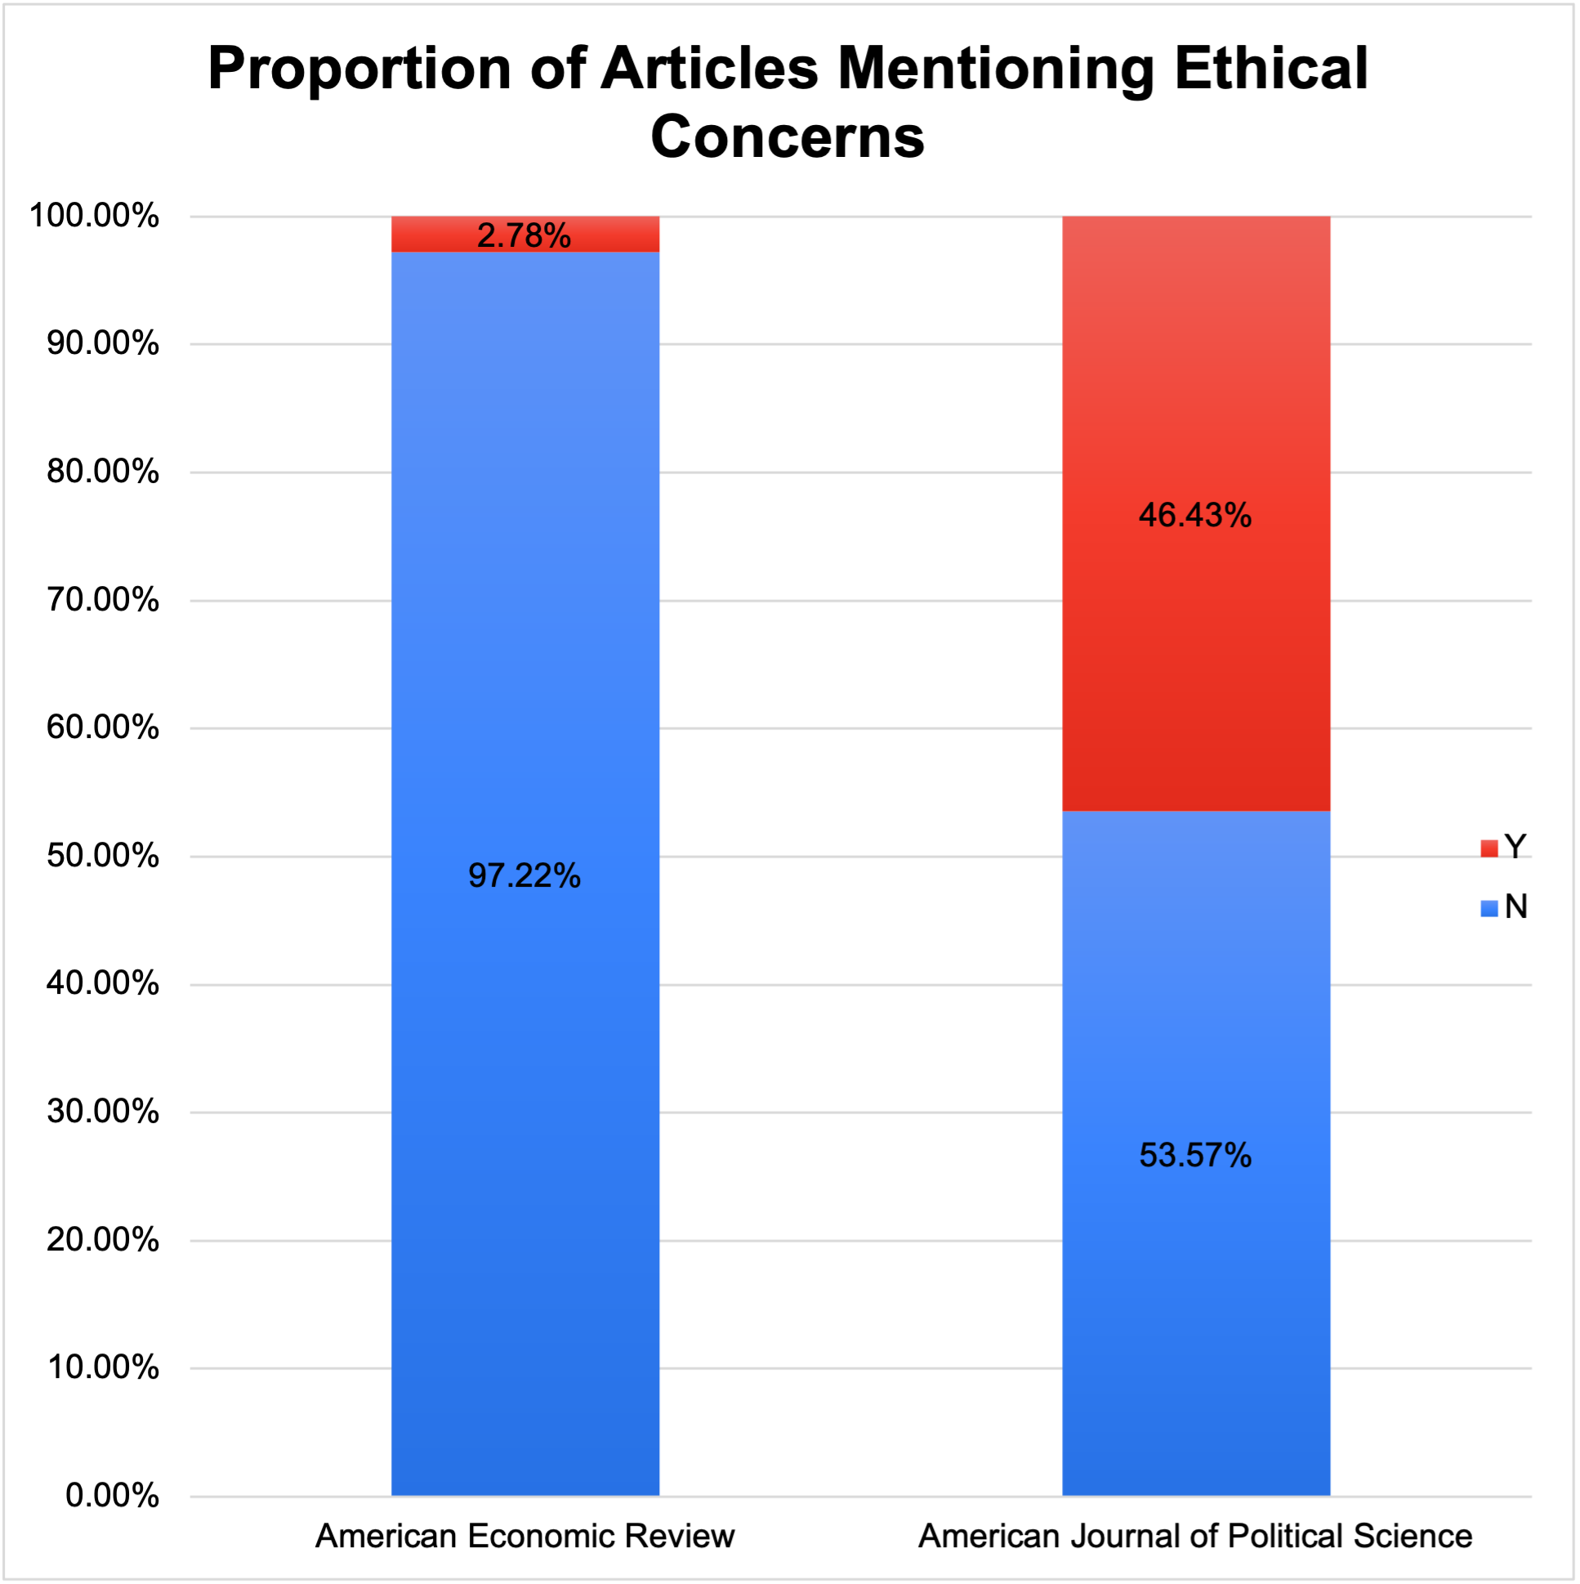
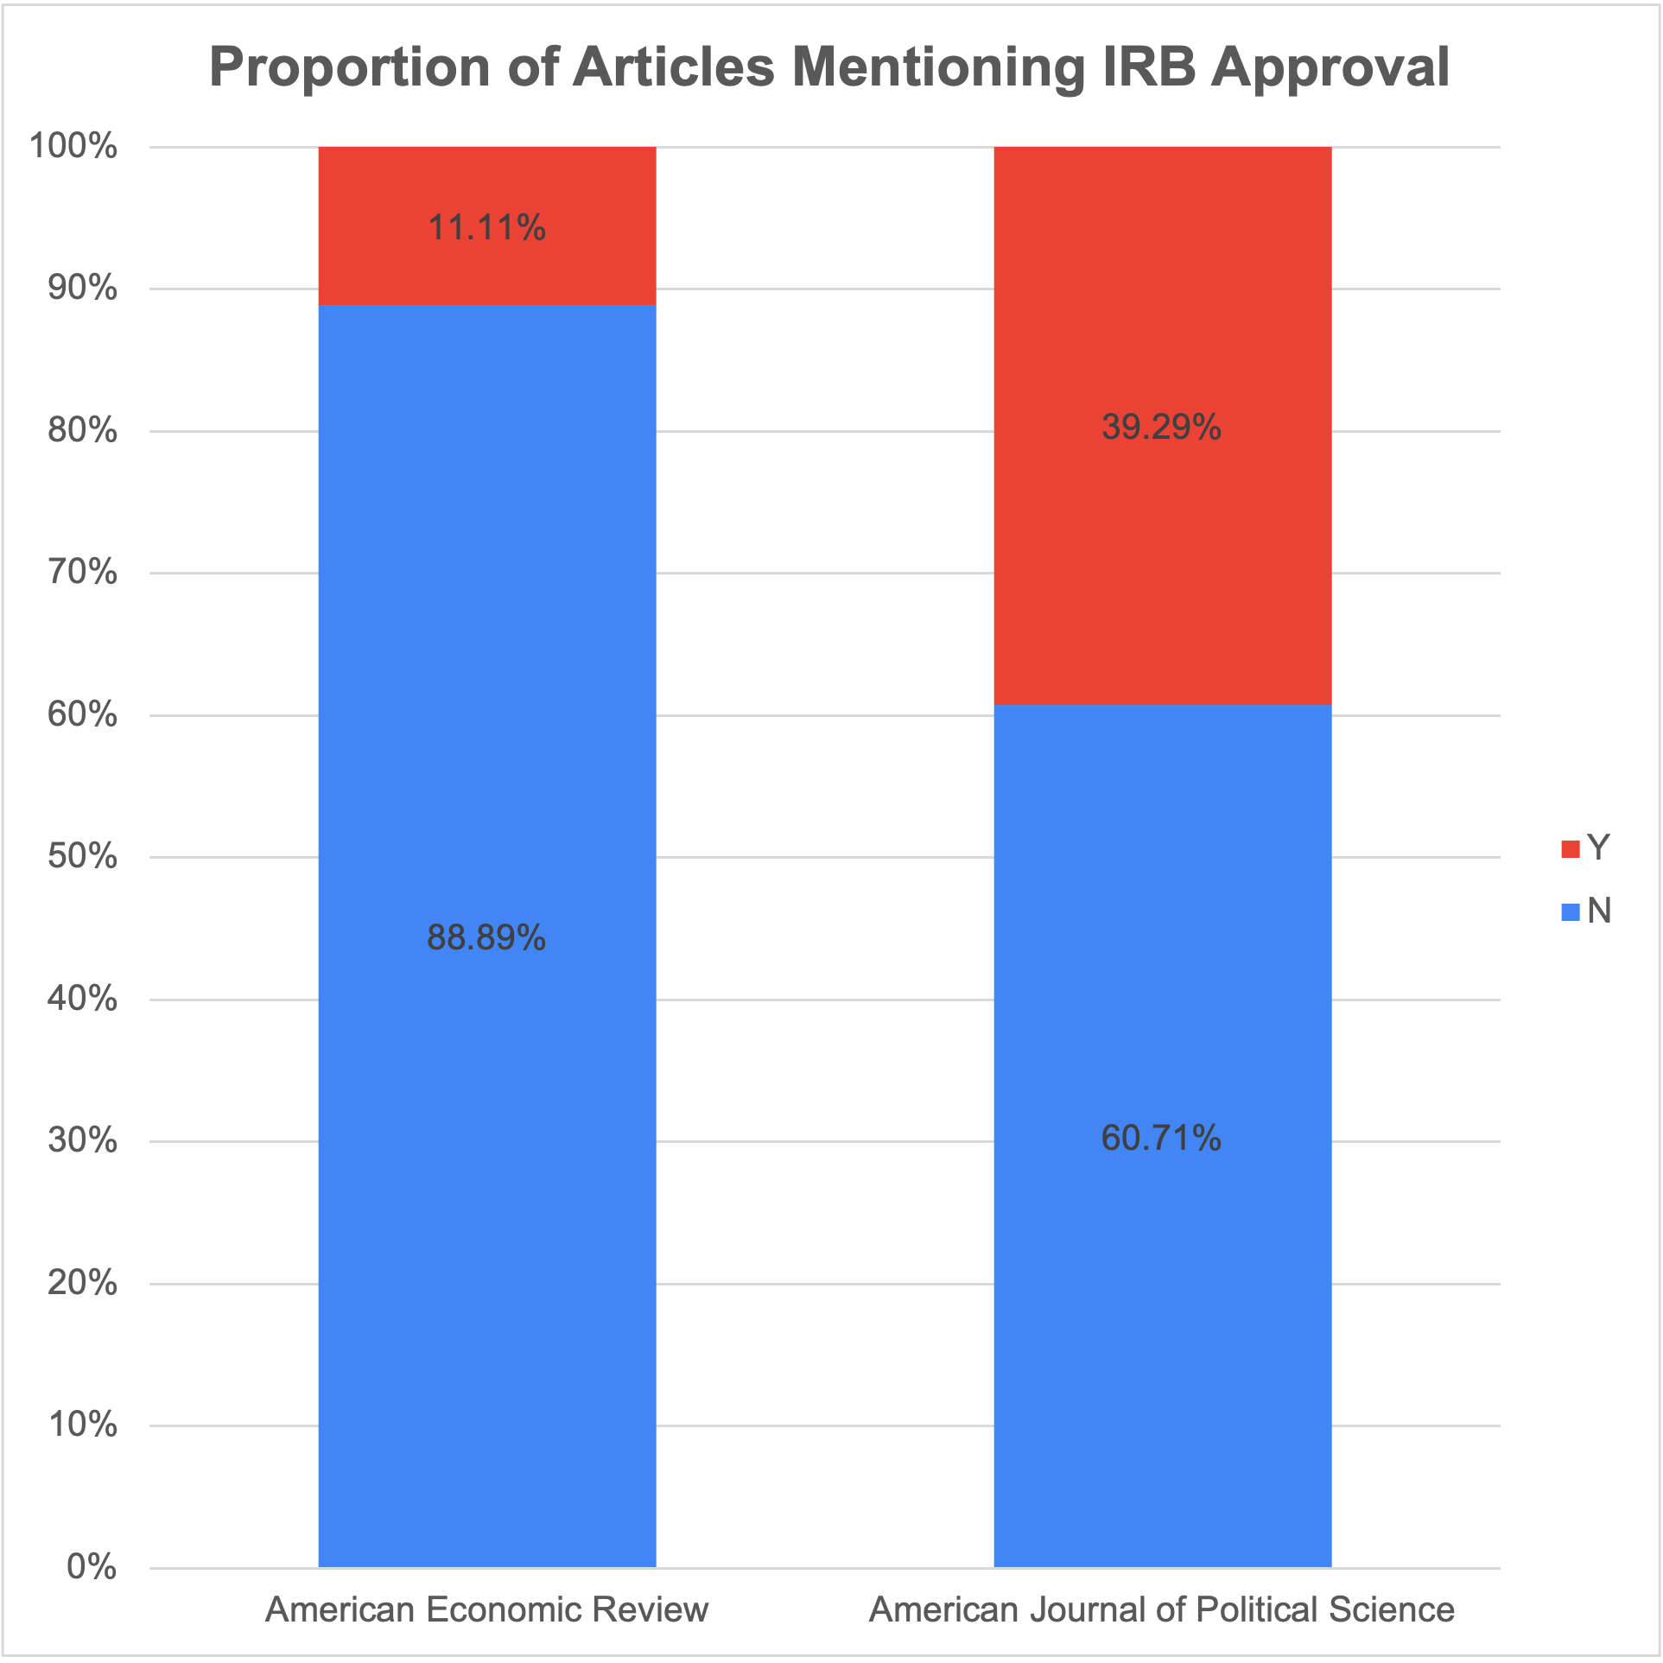
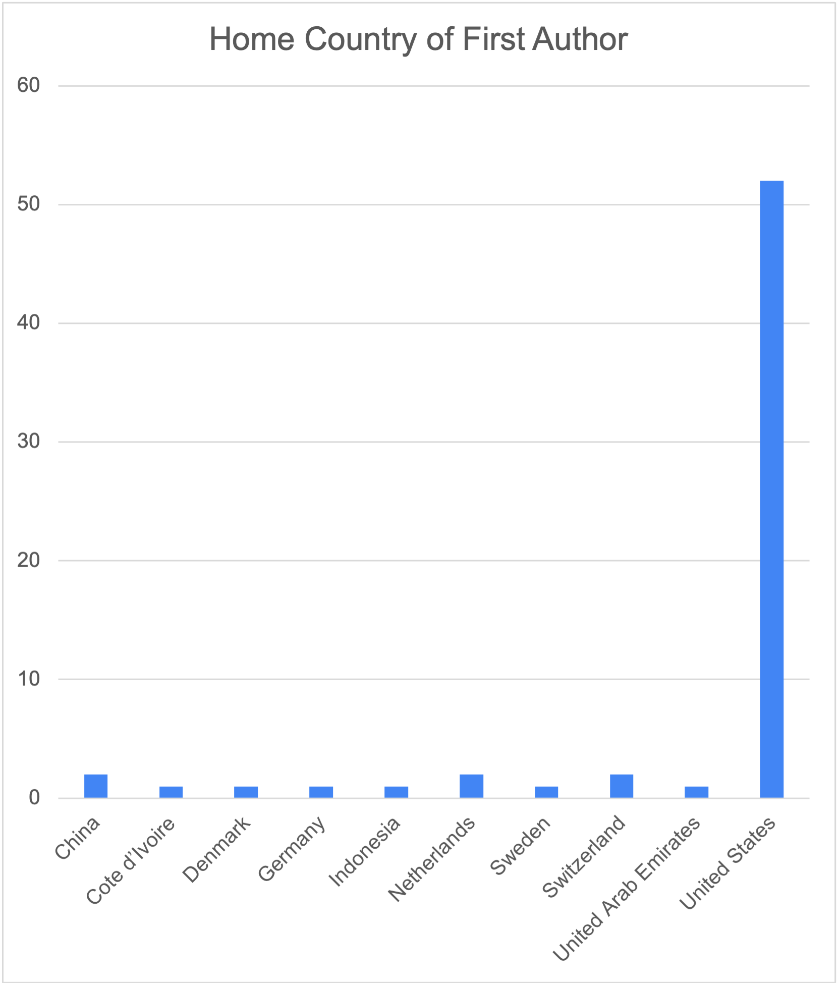
Pilot study results

Slide 12
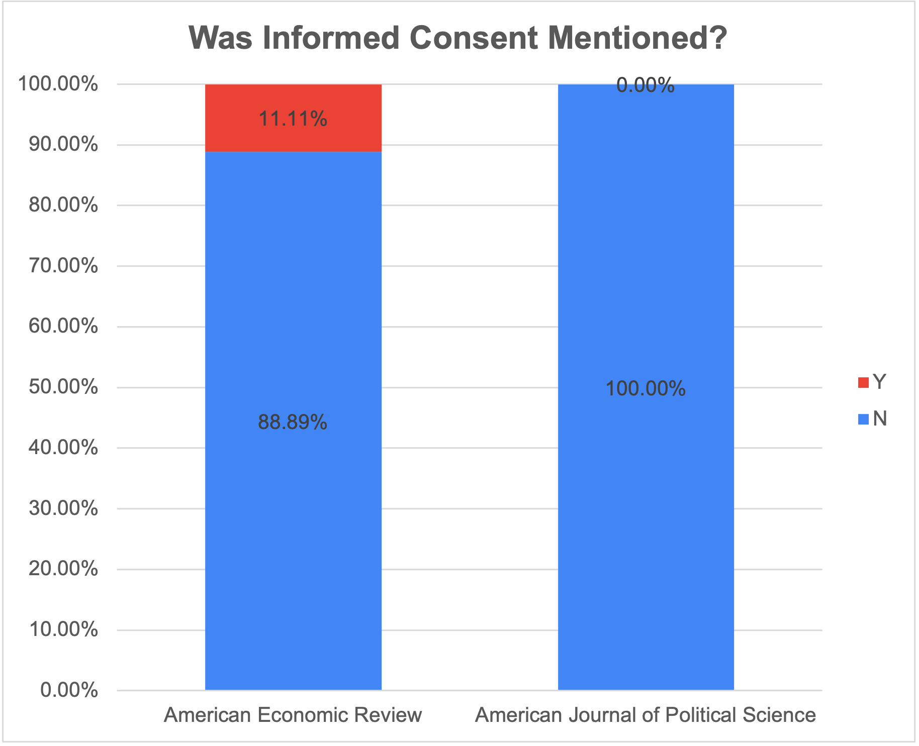
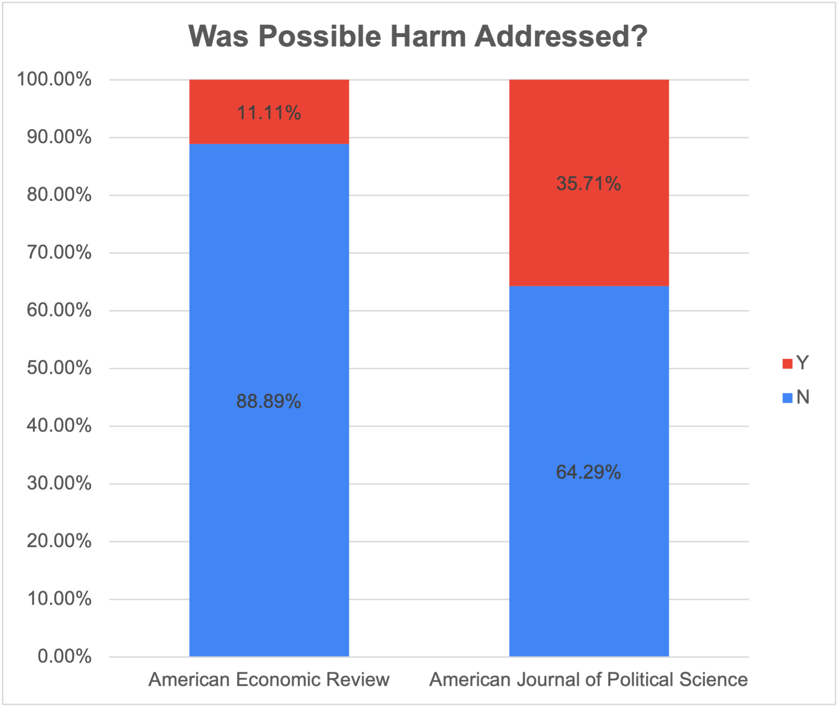
Pilot study results
Notes:
Note: It must be emphasized that I am, in no way, making the argument that any of the researchers involved in any of the experiments presented in the articles surveyed behaved unethically, or that the researchers were not concerned with ethical guidelines in their research design and execution process. The fundamental issue is that because these concerns were so rarely openly discussed and addressed, there is no way to know what these researchers did in order to create ethical research designs, or how those designs were implemented in such a way as to protect their human subject participants. While there is attention and discussion in some fields about the ethical concerns of field experiments, that discussion seems to be addressed more theoretically or in training (and even there, perhaps not adequately), rather than in the reporting of the actual practice of doing field research. This creates accepted community norms around the discussion of ethical decision making in research design.

Slide 13
Current extension
Text as Data Approach
Narrowing focus to political science
Limit date range to 2012 - present
Including the following journals:
American Journal of Political Science
American Political Science Review
American Politics Research
Journal of Experimental Political Science
Expanding technical skill set
Continuing to refine research question
Social Network Analysis Approach
Focus on co-author network connections
Expanding technical skill set
Is there a connection between an ethical focus and co-authorships?

Slide 14
Directions for future research
Working to develop a comprehensive set of ethical guidelines for social sciences
Text analysis of a sample of syllabi from graduate level research courses
Survey of professors who teach and publish experimental research

